Slide 1
COM2067/ COM267
Chapter 4: Strings

Slide 2
Introduction
Operations on Strings
Arrays of Strings
Pointers and Strings

Slide 3
Introduction
Computers are widely used for word processing applications such as creating, inserting, updating, and modifying textual data.
In C, a string is a null-terminated character array.
This means that after the last character, a null character ('\0') is stored to signify the end of the character array.
For example, if we write char str[] = "HELLO"; then we are declaring an array that has five characters, namely, H, E, L, L, and O.
Apart from these characters, a null character ('\0') is stored at the end of the string.
So, the internal representation of the string becomes HELLO'\0'. To store a string of length 5, we need 5 + 1 locations (1 extra for the null character).
The name of the character array (or the string) is a pointer to the beginning of the string.

Slide 4
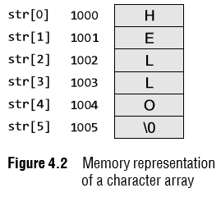
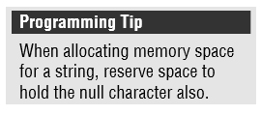
Introduction
Like we use subscripts (also known as index) to access the elements of an array, we can also use subscripts to access the elements of a string.
The subscript starts with a zero (0). All the characters of a string are stored in successive memory locations.
Figure 4.2 shows how str[] is stored in the memory. Thus, in simple terms, a string is a sequence of characters.
For simplicity, the figure shows that H is stored at memory location 1000 but in reality, the ASCII code of a character is stored in the memory and not the character itself.
So, at address 1000, 72 will be stored as the ASCII code for H is 72.

Slide 5
Introduction
The statement char str[] = "HELLO"; declares a constant string, as we have assigned a value to it while declaring the string.
The general form of declaring a string is char str[size];
When we declare the string like this, we can store size–1 characters in the array because the last character would be the null character.
For example, char m[100]; can store a maximum of 99 characters.
The other way to initialize a string is to initialize it as an array of characters.
For example, char str[] = {'H', 'E', 'L', 'L', 'O', '\0'}; In this example, we have explicitly added the null character.

Slide 6
Introduction
We can also declare a string with size much larger than the number of elements that are initialized. For example, consider the statement below. char str [10] = "HELLO";
In such cases, the compiler creates an array of size 10; stores "HELLO" in it and finally terminates the string with a null character. Rest of the elements in the array are automatically initialized to NULL.
Now consider the following statements: char str[3]; str = "HELLO";
The above initialization statement is illegal in C and would generate a compile-time error because of two reasons.
First, the array is initialized with more elements than it can store.
Second, initialization cannot be separated from declaration.

Slide 7
Introduction
Reading Strings
If we declare a string by writing char str[100];
Then str can be read by the user in three ways:
1. using scanf function,
2. using gets() function, and
3. using getchar() function repeatedly.
Strings can be read using scanf() by writing scanf("%s", str);
scanf() function is well known and easy to use,
the main pitfall of using this function is that the function terminates as soon as it finds a blank space.
For example, if the user enters Hello World, then the str will contain only Hello.

Slide 8
Introduction
Reading Strings
The next method of reading a string is by using the gets() function.
The string can be read by writing gets(str); gets() is a simple function that overcomes the drawbacks of the scanf() function.
The gets() function takes the starting address of the string which will hold the input.
The string inputted using gets() is automatically terminated with a null character.

Slide 9
Introduction
Reading Strings
Strings can also be read by calling the getchar() function repeatedly to read a sequence of single characters (unless a terminating character is entered) and simultaneously storing it in a character array as shown below.
i=0;
ch = getchar();// Get a character
while(ch != '*')
{
str[i] = ch;// Store the read character in str
i++;
ch = getchar();// Get another character
}
str[i] = '\0';// Terminate str with null character
Note that in this method, you have to deliberately append the string with a null character.
The other two functions automatically do this.

Slide 10
Introduction
Writing Strings
Strings can be displayed on the screen using the following three ways:
1. using printf() function,
2. using puts() function, and
3. using putchar() function repeatedly.
Strings can be displayed using printf() by writing
printf("%s", str);
The precision specifies the maximum number of characters to be displayed, after which the string is truncated. The below statement would print only the first three characters in a total field of five characters.
printf ("%5.3s", str);
Also these characters would be right justified in the allocated width.
To make the string left justified, we must use a minus sign. printf ("%–5.3s", str);

Slide 11
Introduction
The next method of writing a string is by using puts() function.
A string can be displayed by writing puts(str);
Strings can also be written by calling the putchar() function repeatedly to print a sequence of single characters.
i=0;
while(str[i] != '\0')
{
putchar(str[i]);
// Print the character on the screen
i++;
}

Slide 12
Operations on Strings
Finding Length of a String
The number of characters in a string constitutes the length of the string.
For example, LENGTH("C PROGRAMMING IS FUN") will return 20.
Note that even blank spaces are counted as characters in the string.
The library function strlen(s1) which is defined in string.h returns the length of string s1.

Slide 13
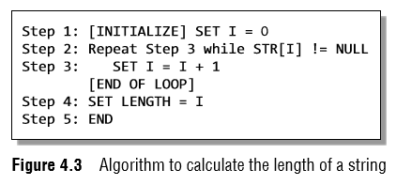
Operations on Strings
Figure 4.3 shows an algorithm that calculates the length of a string.
In this algorithm, I is used as an index for traversing string STR.
To traverse each and every character of STR, we increment the value of I.
Once we encounter the null character, the control jumps out of the while loop and the length is initialized with the value of I.
Note The library function strlen(s1) which is defined in string.h returns the length of string s1.

Slide 14
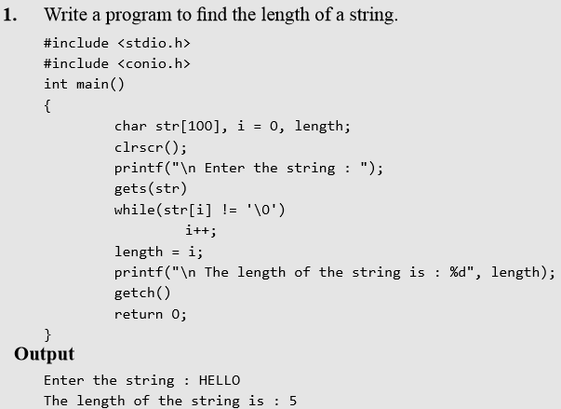
Operations on Strings

Slide 15
Operations on Strings
Converting Characters of a String into Upper/ Lower Case
The ASCII code for A–Z varies from 65 to 91 and the ASCII code for a–z ranges from 97 to 123.
So, if we have to convert a lower case character into uppercase, we just need to subtract 32 from the ASCII value of the character.
And if we have to convert an upper case character into lower case, we need to add 32 to the ASCII value of the character.
The library functions toupper() and tolower() which are defined in ctype.h convert a character into upper and lower case, respectively.

Slide 16
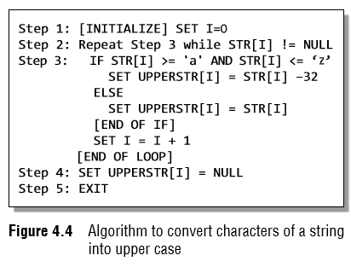
Operations on Strings
Figure 4.4 shows an algorithm that converts the lower case characters of a string into upper case.
Using I as the index of STR, we traverse each character of STR from Step 2 to 3.
If the character is in lower case, then it is converted into upper case by subtracting 32 from its ASCII value.
But if the character is already in upper case, then it is copied into the UPPERSTR string.
Finally, when all the characters have been traversed, a null character is appended to UPPERSTR (as done in Step 4).

Slide 17
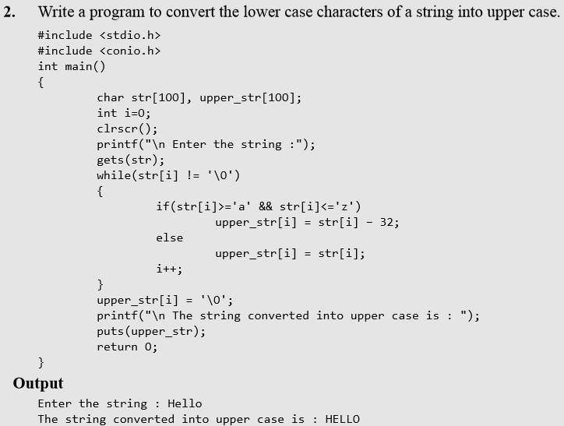
Operations on Strings

Slide 18
Operations on Strings
Appending a String to Another String
Appending one string to another string involves copying the contents of the source string at the end of the destination string.
For example, if S1 and S2 are two strings, then appending S1 to S2 means we have to add the contents of S1 to S2.
S1 is the source string and S2 is the destination string.
The appending operation would leave the source string S1 unchanged and the destination string S2 = S2 + S1.
Note The library function strcat(s1, s2) which is defined in string.h concatenates string s2 to s1.

Slide 19
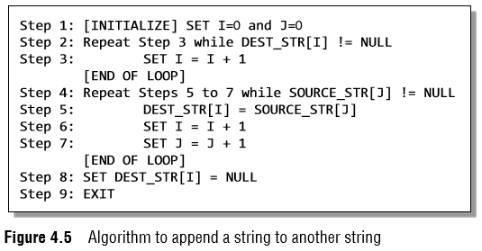
Operations on Strings
Figure 4.5 shows an algorithm that appends two strings.
In this algorithm, we first traverse through the destination string to reach its end, that is, reach the position where a null character is encountered.
The characters of the source string are then copied into the destination string starting from that position.
Finally, a null character is added to terminate the destination string.

Slide 20
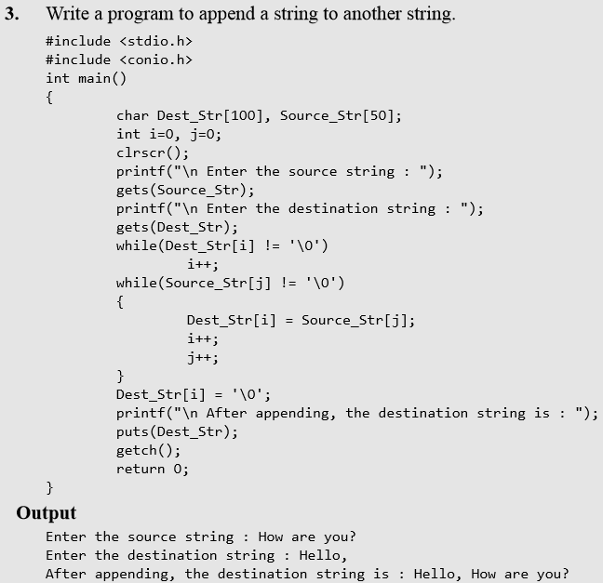
Operations on Strings

Slide 21
Operations on Strings
Comparing Two Strings
If S1 and S2 are two strings, then comparing the two strings will give either of the following results:
(a) S1 and S2 are equal
(b) S1>S2, when in dictionary order, S1 will come after S2
(c) S1<S2, when in dictionary order, S1 precedes S2
To compare the two strings, each and every character is compared from both the strings.
If all the characters are the same, then the two strings are said to be equal.
Note The library function strcmp(s1, s2) which is defined in string.h compares string s1 with s2.

Slide 22
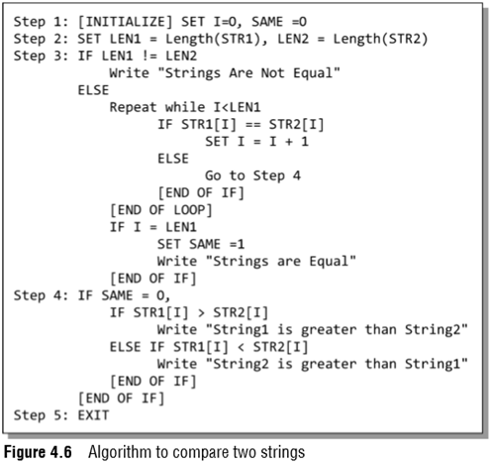
Operations on Strings
Figure 4.6 shows an algorithm that compares two strings.
We first check whether the two strings are of the same length.
If not, then there is no point in moving ahead.
If the two strings are of the same length, then we compare character by character to check if all the characters are same.
If yes, then the variable SAME is set to 1.
Else, if SAME = 0, then we check which string precedes the other in the dictionary order

Slide 23
Operations on Strings
Reversing a String
If S1 = "HELLO", then reverse of S1 = "OLLEH".
To reverse a string, we just need to swap the first character with the last, second character with the second last character, and so on.
Note The library function strrev(s1) which is defined in string.h reverses all the characters in the string except the null character.

Slide 24
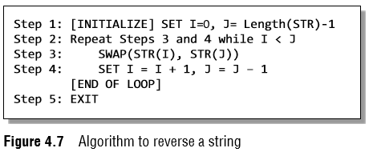
Operations on Strings
Figure 4.7 shows an algorithm that reverses a string.
In Step 1, I is initialized to zero and J is initialized to the length of the string –1.
In Step 2, a while loop is executed until all the characters of the string are accessed.
In Step 4, we swap the ith character of STR with its jth character.
As a result, the first character of STR will be replaced with its last character, the second character will be replaced with the second last character of STR, and so on.
In Step 4, the value of I is incremented and J is decremented to traverse STR in the forward and backward directions, respectively.

Slide 25
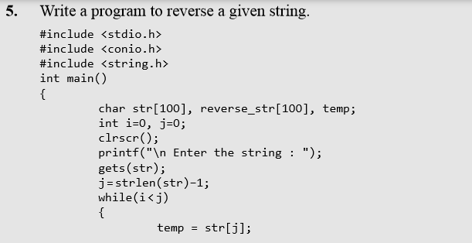
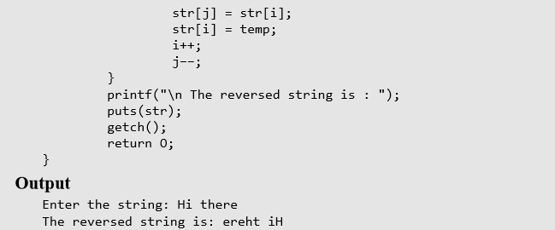
Operations on Strings

Slide 26
Operations on Strings
Extracting a Substring from a String
To extract a substring from a given string, we need the following three parameters:
1. the main string,
2. the position of the first character of the substring in the given string, and
3. the maximum number of characters/length of the substring.
For example, if we have a string str[] = "Welcome to the world of programming";
Then, SUBSTRING(str, 15, 5) = world

Slide 27
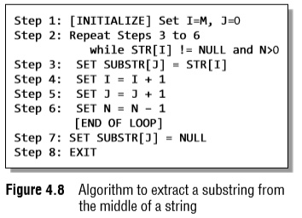
Operations on Strings
Figure 4.8 shows an algorithm that extracts a substring from the middle of a string.
In this algorithm, we initialize a loop counter I to M, that is, the position from which the characters have to be copied.
Steps 3 to 6 are repeated until N characters have been copied.
With every character copied, we decrement the value of N.
The characters of the string are copied into another string called the SUBSTR.
At the end, a null character is appended to SUBSTR to terminate the string.

Slide 28
Operations on Strings
Inserting a String in the Main String
The insertion operation inserts a string S in the main text T at the kth position.
The general syntax of this operation is
INSERT(text, position, string).
For example,
INSERT("XYZXYZ", 3, "AAA") = "XYZAAAXYZ"

Slide 29
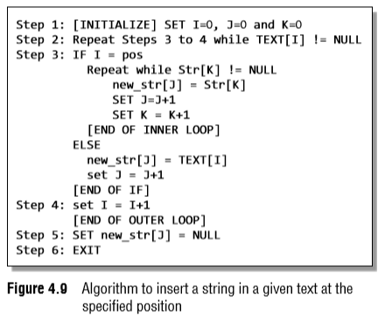
Operations on Strings
Figure 4.9 shows an algorithm to insert a string in a given text at the specified position.
This algorithm first initializes the indices into the string to zero.
From Steps 3 to 5, the contents of NEW_STR are built.
If I is exactly equal to the position at which the substring has to be inserted, then the inner loop copies the contents of the substring into NEW_STR.
Otherwise, the contents of the text are copied into it.

Slide 30
Operations on Strings
Pattern Matching
This operation returns the position in the string where the string pattern first occurs.
For example, INDEX("Welcome to the world of programming", "world") = 15

Slide 31
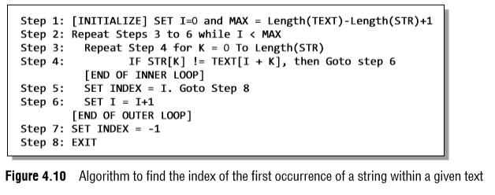
Operations on Strings
Figure 4.10 shows an algorithm to find the index of the first occurrence of a string within a given text.
In this algorithm, MAX is initialized to length(TEXT) – Length(STR) + 1.
For example, if a text contains 'Welcome To Programming' and the string contains 'World', in the main text, we will look for at the most 22 – 5 + 1 = 18 characters because after that there is no scope left for the string to be present in the text.
Steps 3 to 6 are repeated until each and every character of the text has been checked for the occurrence of the string within it.
In the inner loop in Step 3, we check the n characters of string with the n characters of text to find if the characters are same.
If it is not the case, then we move to Step 6, where I is incremented.
If the string is found, then the index is initialized with I, else it is set to –1.

Slide 32
Operations on Strings
Deleting a Substring from the Main String
The deletion operation deletes a substring from a given text.
DELETE(text, position, length).
For example,
DELETE("ABCDXXXABCD", 4, 3) = "ABCDABCD"

Slide 33
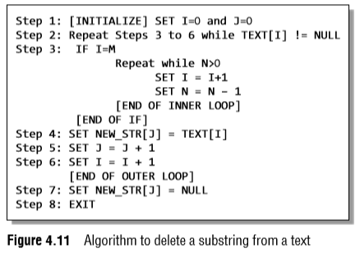
Operations on Strings
Figure 4.11 shows an algorithm to delete a substring from a given text. In this algorithm, we first initialize the indices to zero.
Steps 3 to 6 are repeated until all the characters of the text are scanned.
If I is exactly equal to M (the position from which deletion has to be done), then the index of the text is incremented and N is decremented.
N is the number of characters that have to be deleted starting from position M.
However, if I is not equal to M, then the characters of the text are simply copied into the NEW_STR.

Slide 34
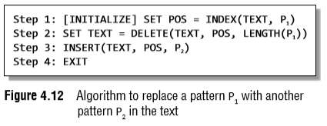
Operations on Strings
Replacing a Pattern with Another Pattern in a String
The replacement operation is used to replace the pattern P1 by another pattern P2.
REPLACE(text, pattern1, pattern2).
For example, ("AAABBBCCC", "BBB", "X") = AAAXCCC
Figure 4.12 shows an algorithm to replace a pattern P1 with another pattern P2 in the text.
The algorithm is very simple, where we first find the position POS, at which the pattern occurs in the text, then delete the existing pattern from that position and insert a new pattern there.

Slide 35
Arrays of Strings
Till now we have seen that a string is an array of characters.
For example, if we say char name[] = "Mohan", then the name is a string (character array) that has five characters.
Now, suppose that there are 20 students in a class and we need a string that stores the names of all the 20 students.
Such an array of strings would store 20 individual strings.
char names[20][30];
Here, the first index will specify how many strings are needed and the second index will specify the length of every individual string.

Slide 36
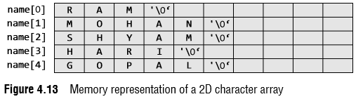
Arrays of Strings
Let us see the memory representation of an array of strings.
If we have an array declared as char name[5][10] = {"Ram", "Mohan", "Shyam", "Hari", "Gopal"};
Then in the memory, the array will be stored as shown in Fig. 4.13.
By declaring the array names, we allocate 50 bytes.
But the actual memory occupied is 27 bytes.
Thus, we see that about half of the memory allocated is wasted.

Slide 37
Pointers and Strings
Now, consider the following program that prints a text.
#include <stdio.h>
int main()
{
char str[] = "Hello";
char *pstr;
pstr = str;
printf("\n The string is : ");
while(*pstr != '\0')
{
printf("%c", *pstr);
pstr++;
}
return 0;
}
Output The string is: Hello

Slide 38
Pointers and Strings
Instead of using the while loop, we could straightaway use the function puts(str)
int puts(const char *s);
Here the const modifier is used to assure that the function dose not modify the contents pointed to by the source pointer.
The address of the string is passed to the function as an argument.
Thus, writing puts(str) means passing the address of str[0].
Similarly when we write puts(pstr); we are passing the same address, because we have written pstr = str;.

Slide 39
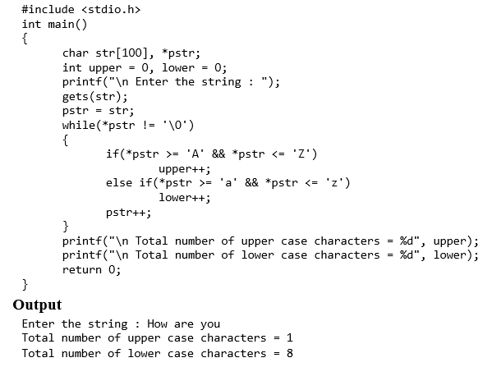
Pointers and Strings

